Slide 1
SNS ACADEMY
A fingerprint International School
Affiliated to CBSE New Delhi
Affiliation No :1930610
GRADE XI A (2020-21)
COURSE NAME : ENGLISH (301)
(HORNBILL)
Lesson –Discovering Tut: the Sage Continues
A.R.WILLIAMS

Slide 18
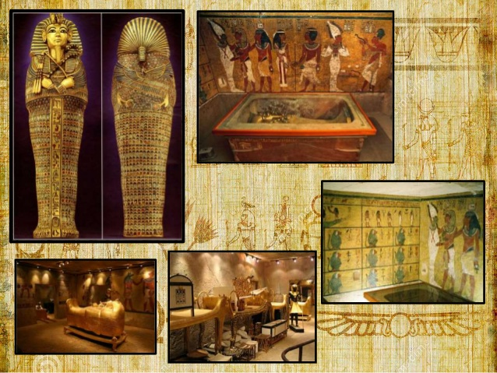

Slide 19
https://www.youtube.com/watch?v=EZYMC-bP7gE

